Slide 1




Build your own Virtual Assistant
Asish Padhy
@AsishPadhy

Slide 2


Hello, Hola, Namaste,
Ni hao…
Tech Lover and Enthusiast
14+ years of building solutions
Architect and Developer in M365, Azure, AI and lot many ...
Dream it, Believe it, Build it
@AsishPadhy

Slide 3
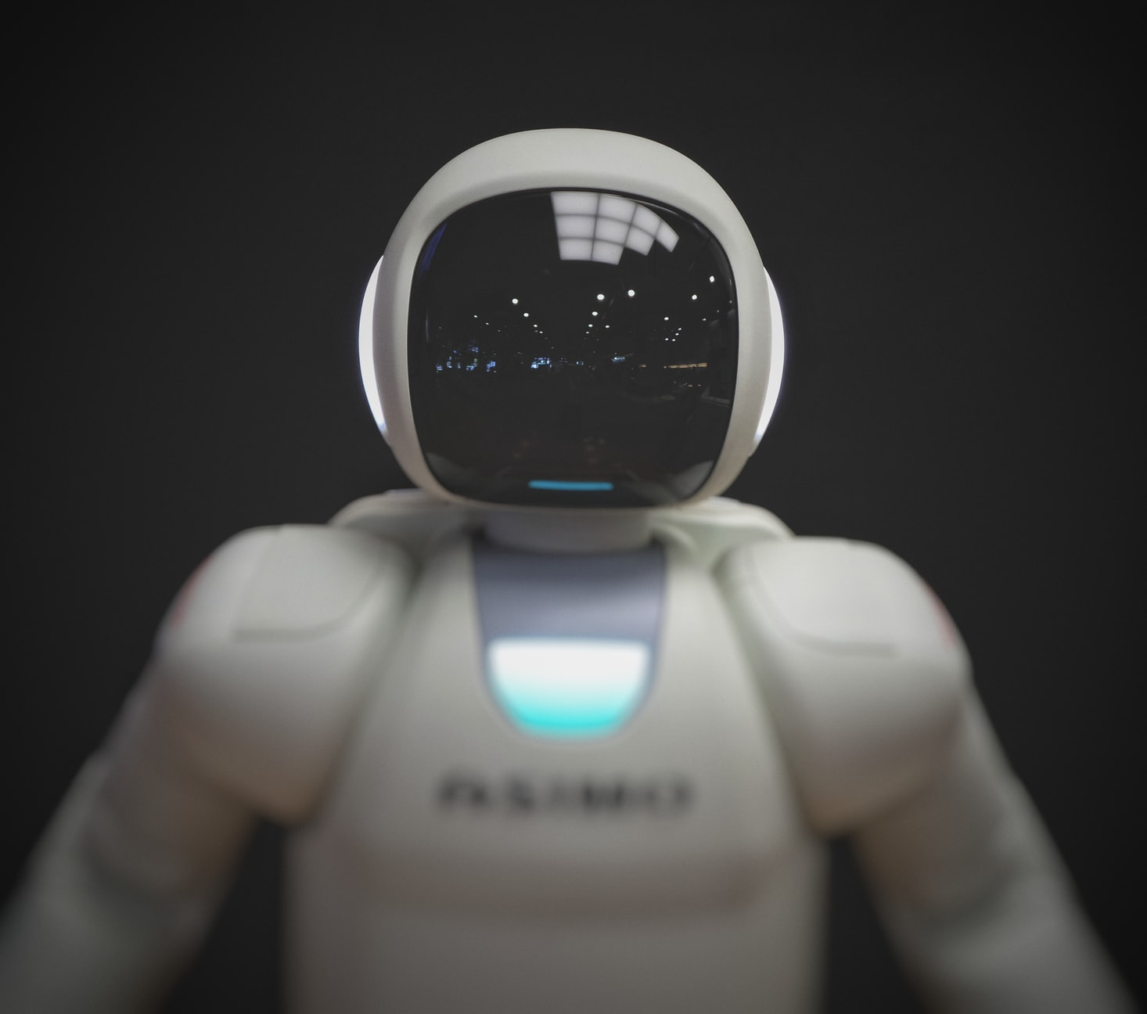




Agenda
Microsoft Teams and Bots
Virtual Assistant Intro
What it means for organization
Demo
Components & Template
Design Flow
Skills
Use Cases and Things to know
@AsishPadhy

Slide 4
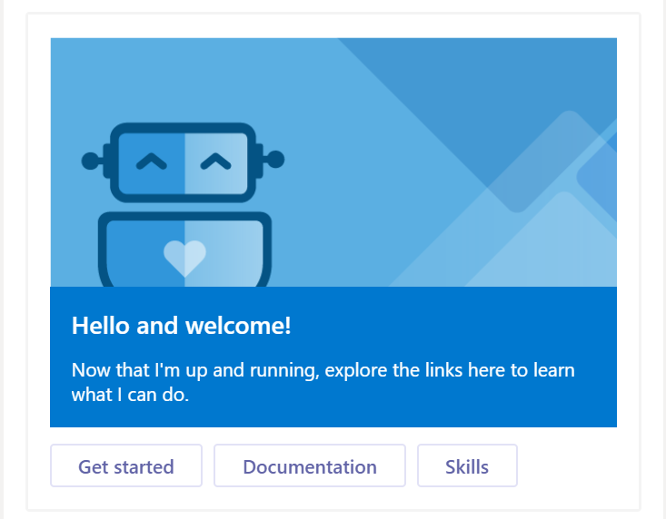
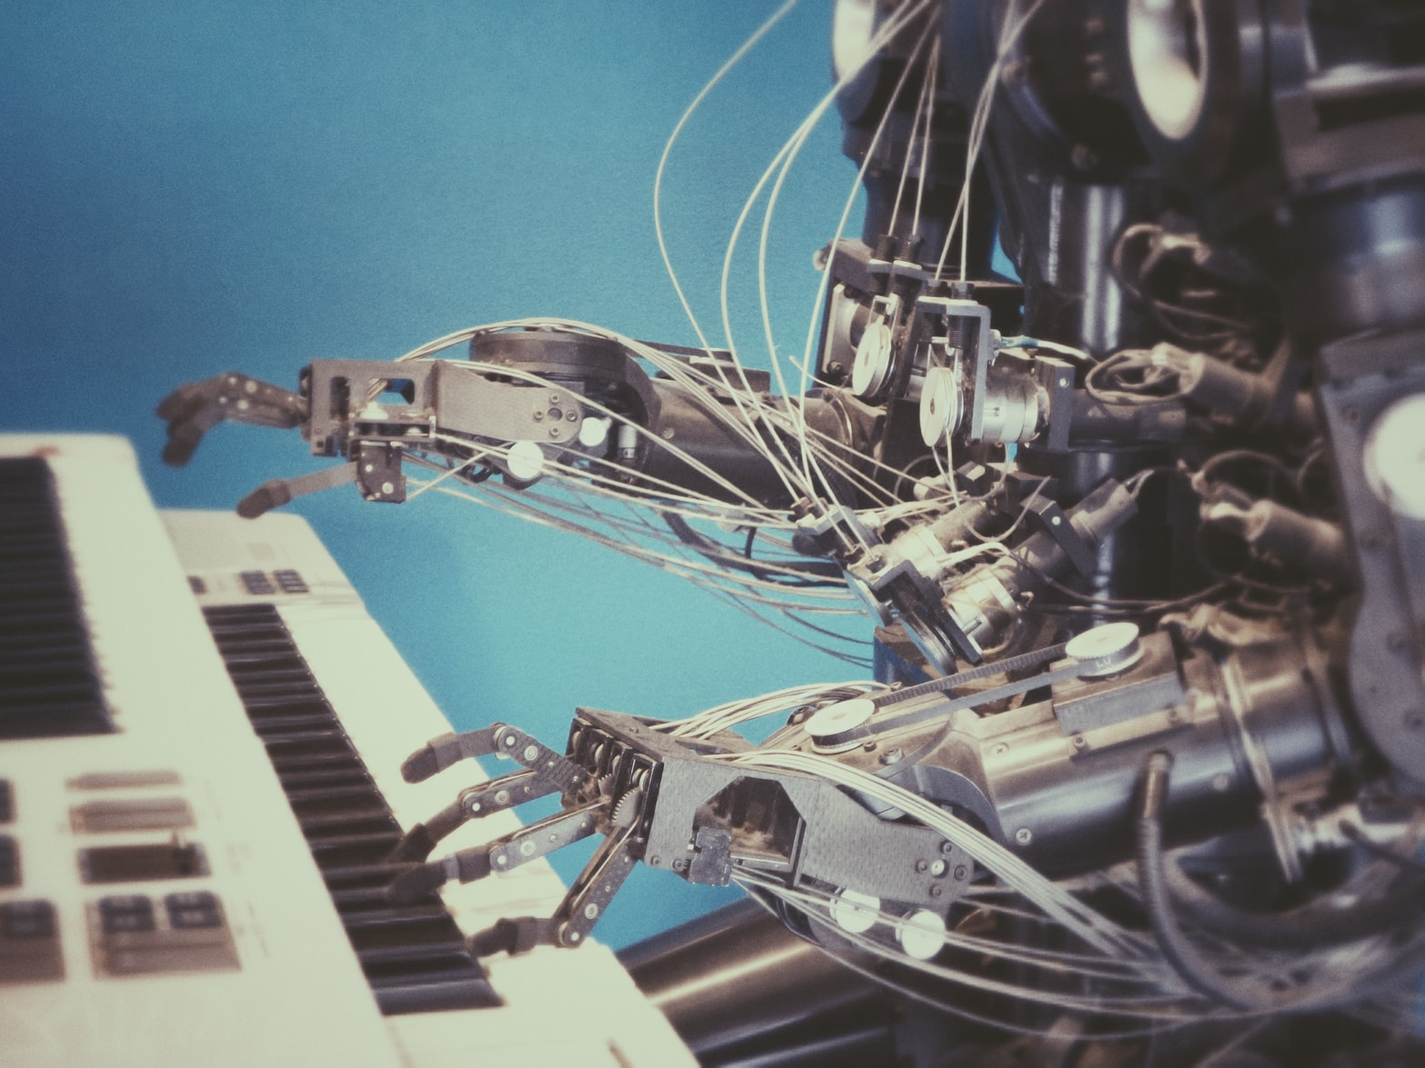
Virtual Assistant
What is a Virtual Assistant ?
Cumulative Bots Experience tailored to your brand
Conversational Assistant across broad range of applications
Personalized to Users and brand
Extensible with Skills
Provides a great starting point with Templates
@AsishPadhy

Slide 5
Virtual Assistant
What it means for an organization
Starting Point
Custom Abilities
Experience and build value
Start with an existing template build on Microsoft experiences
Focusses on combination of services and strength of using each
Build and extend as you go
Business Ownership
Owned Processes
Add skills / abilities as per your business requirement
Provide more skillful actions for user actions such as automated prompts, activity tracking etc.
Create a custom flow that works with your business processes
Create own knowledge base
Get information specific to particular business requirements
Create a map of existing data with the business need
@AsishPadhy

Slide 6
Virtual Assistant
Tour
Skills
New or existing bots
Extensible
Programmable
Components
Channels
Access Points
E.g. Teams, Emails, Web, Speech
Knowledge Sources
Document Repositories
Line of Business databases
CRM and Employee Systems
Cognitive Services
Offload complexity and intelligence
LUIS, QNA Maker, Azure Search
@AsishPadhy

Slide 7
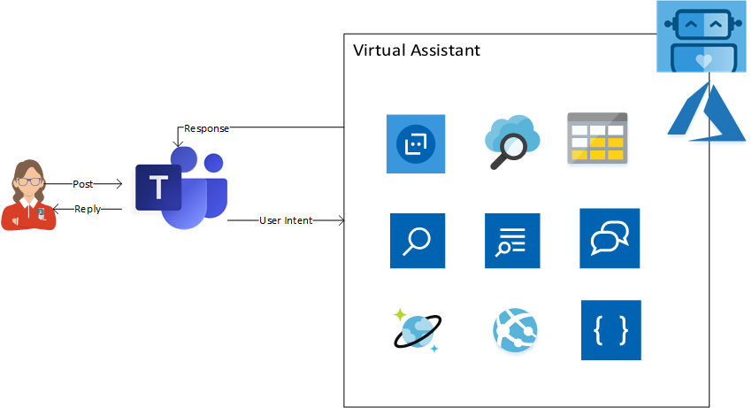
Microsoft Teams and Virtual Assistants (VA)
Teams acts hosting interface for Bots
VA’s are code running in Azure App Service and listening to Team events
VA’s use multiple Azure Cognitive Services such as
  LUIS
  QNA Maker
  Image
  Speech
Responses from VA’s are fed back using Channels such as Teams App
High Level Design
@AsishPadhy

Slide 8
Virtual Assistant
Template
Virtual Assistant
Dispatch
LUIS
QnA
Skills
Bot Skill 1
Bot Skill 2
Telemetry
Content Moderator
Focus on Routing requests
Core scalability with Dispatch tool
Support for Telemetry (analytics)
Support for Content Moderation
Core support from LUIS and QnA services
Extensibility with Skills with existing bot functionalities
@AsishPadhy

Slide 9
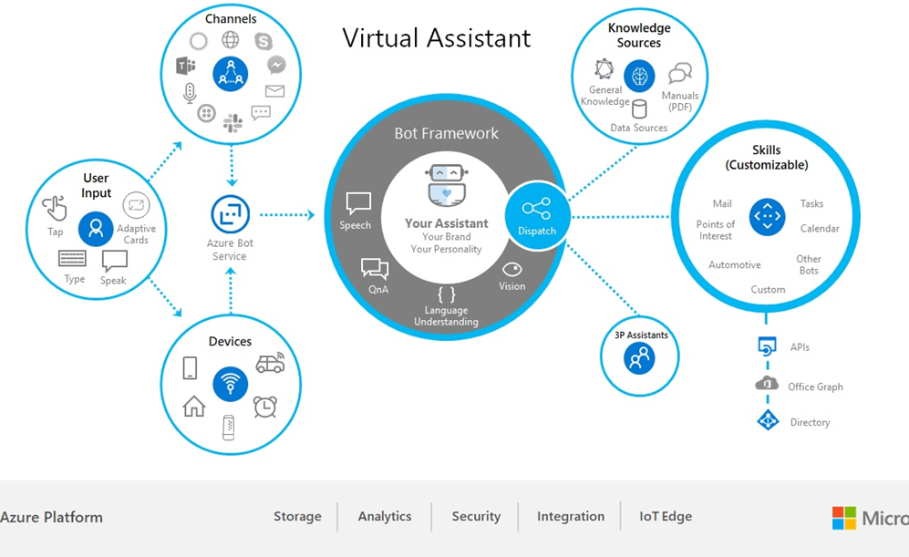
Virtual Assistant Flow
Design Flow
  Knowledge Sources
  Channels
  User Inputs
  Skills
  Virtual Assistant
  QNA Maker
  Custom Skills
  Azure Hosting
  Channel Hosting
  AI Hosting
Define
Build
Deploy
@AsishPadhy

Slide 10


Virtual Assistant build
STEPS
Get an Azure subscription
Set up Subscription and LUIS
Install prerequisites for VA setup
Prepare cost and hosting plan
Create a Virtual Assistant using the template
Deploy Azure Resources
Customize the solution to your organization needs
Build and Add Skills
Start using Virtual Assistant in Teams
@AsishPadhy

Slide 11

Custom Skills
Abilities
Provided Skill template as a starting point
Extend an existing custom bot to skill
Add the skill to virtual assistant using botskills command
Update the dispatch skill in assistant
Support Authentication
Available Skills CLI tool
@AsishPadhy

Slide 12
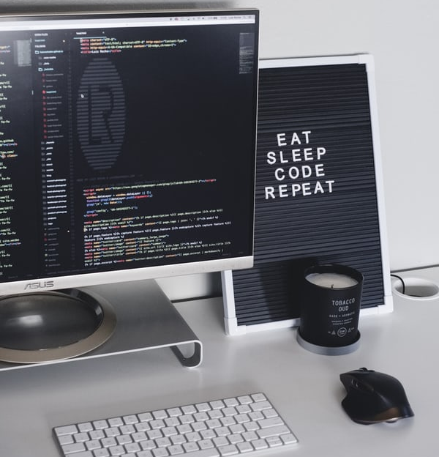

Demo
Let’s Code
@AsishPadhy

Slide 13
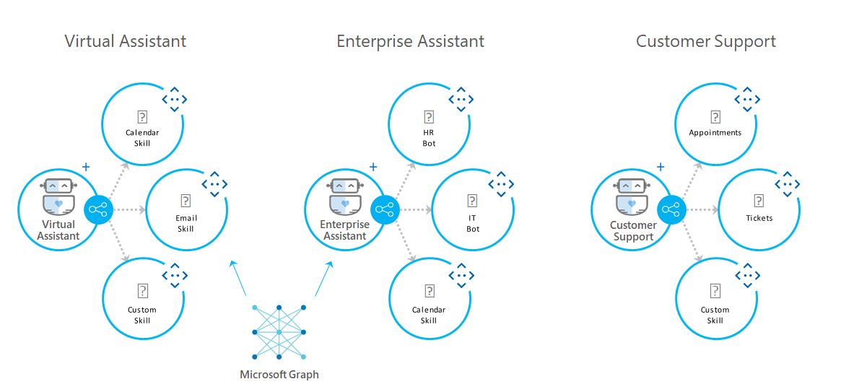

Skills
Custom Abilities
Provide a way to expand on available or new conversational or AI abilities
Addons at Organizational scope
Skills allows to reuse existing conversational features
Some startup template skills provided by Microsoft
E.g.
  Email Skill
  Todo Skill
  Calendar Skill
@AsishPadhy

Slide 14

Use cases
Single routing interface for multiple bot scenarios
Automated learning platform with extension to multiple channels
E.g.
Customer Service Request
Planner and Organizer
Go to Help / Support Request
@AsishPadhy

Slide 15
Things to know
Virtual Assistant
Skills
Update parameters.template.json to customize the virtual assistant azure resources deployment
Quickly train QnA and LUIS using LU files in Resources folder under Deployment
Activate LUIS and assign authoring key to prevent service drops
Identify load and plan cost for Azure Search RPUs
Update Skills dialog for custom prompts and flow
Deploy the skill to Virtual Assistant after complete individual testing using bot emulator
Don’t make skill too specific or heavy. Keep it light and scalable
Create more granular independent skills
Use Direct line Speech for easy accessibility
@AsishPadhy

Slide 16
Help
https://docs.microsoft.com/en-us/azure/bot-service/bot-builder-virtual-assistant-introduction?view=azure-bot-service-4.0
Virtual assistant
Skills
https://docs.microsoft.com/en-us/azure/bot-service/bot-builder-skills-overview?view=azure-bot-service-4.0
Sample Skills Repo (C#)
https://github.com/microsoft/botframework-solutions/tree/master/skills/csharp
Create Virtual Assistant
https://microsoft.github.io/botframework-solutions/virtual-assistant/tutorials/create-assistant/csharp/1-intro/
Create Skill
https://microsoft.github.io/botframework-solutions/skills/tutorials/create-skill/csharp/1-intro/
@AsishPadhy

Slide 17

Thank You!
Asish Padhy
Twitter
@asishpadhy
LinkedIn
https://linkedin.com/in/asishpadhy
Blog
https://asishpadhy.com

