Slide 1
Site scripts and Site Design
Asish Padhy

Slide 2

About me
SharePoint, Office 365 and Azure Solutions Consultant at Kloud Solutions
12 years of experience working on SharePoint and MS Technologies
I am a Consultant, Architect, Project Lead and always a Developer.
Microsoft Certified Professional in SharePoint
https://www.linkedin.com/in/asishpadhy
https://asishposts.wordpress.com
https://blog.kloud.com.au/author/asishpadhykloud/
https://twitter.com/asishpadhy - @asishpadhy

Slide 3
Agenda
Lets do a Demo !!
Site Design and Site Script
Software and Tools
Supported SP Artefacts
Steps Overview
Custom Provisioning Overview
PnP Provisioning Walkthrough

Slide 4
Demo

Slide 5
Site Designs
Site designs are like a template.
Implement each time a new site is created to apply a consistent set of actions.
You create site designs and register them in SharePoint to one of the modern template sites: the team site, or communication site.
A site design can run multiple scripts. The script IDs are passed in an array, and they will run in the order listed.

Slide 6
Site Scripts
When a site design is selected, SharePoint creates the new site, and runs site scripts for the site design.
The site scripts detail the work such as creating new lists, or applying a theme.
When the actions in the scripts are completed, SharePoint displays detailed results of those actions in a progress pane.

Slide 7
Software and Tools
Site Scripts and Design
  PowerShell 3.0 or above
  SharePoint Online Management Shell ~ 16.0.7317.1200
Custom Provisioning
  Azure Subscription
  Office 365 subscription or MS Flow subscription
Dev tools
  Azure Storage Emulator
  Postman

Slide 8
Supported Scripting Artefacts
Targeted Release (formerly First Release) Options (Jan 2018)
  Creating a new list
  Applying a theme
  Setting a site logo
  Adding navigation
  Triggering a Microsoft flow
Supported Fields
  The field type can be set to Text, Note, Number, Boolean, User, or DateTime.

Slide 9
Script Steps
Install SharePoint Online Management Shell
Connect to the Tenant Admin Site using Connect-SPOService
Add the Site Script and get the GUID of Site Script
Get-Content 'c:\scripts\site-script.json' -Raw | Add-SPOSiteScript ` -Title "Contoso theme and list“
Add the Site Design
Add-SPOSiteDesign ` -Title "Contoso customer tracking" ` -WebTemplate "64" ` -SiteScripts “<script GUID from above step>" ` -Description "Creates customer list and applies standard theme"

Slide 10
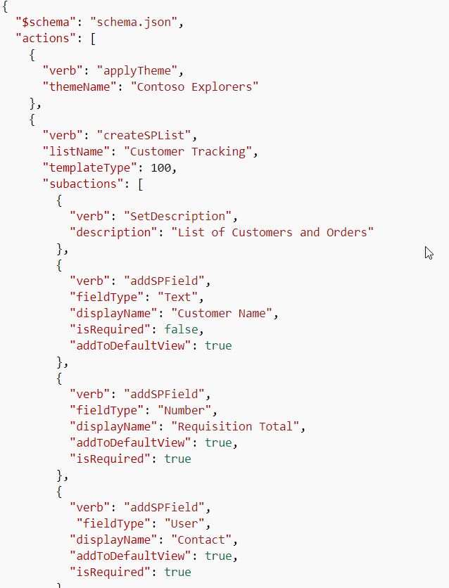
JSON
{
"$schema": "schema.json",
"actions": [
... <one or more verb actions> ...
],
"bindata": { },
"version": 1
};

Slide 11
Custom PnP Provisioning
Helpful for implementations that are not supported in final release
Applicable scenarios
  Custom web components such as SPFx extensions
  Complex Site Templates which need to be standardized
  Complex Document libs, content types that mayn’t be able to scripted by JSON schema

Slide 12
Custom Provisioning Steps
Create an Azure Queue Storage Container
Create a Microsoft Flow with Request Trigger
Put an item into Azure Queue from Flow
Create an Azure Function to trigger from the Queue
Use the Azure Function to apply the PnP Provisioning template

Slide 13
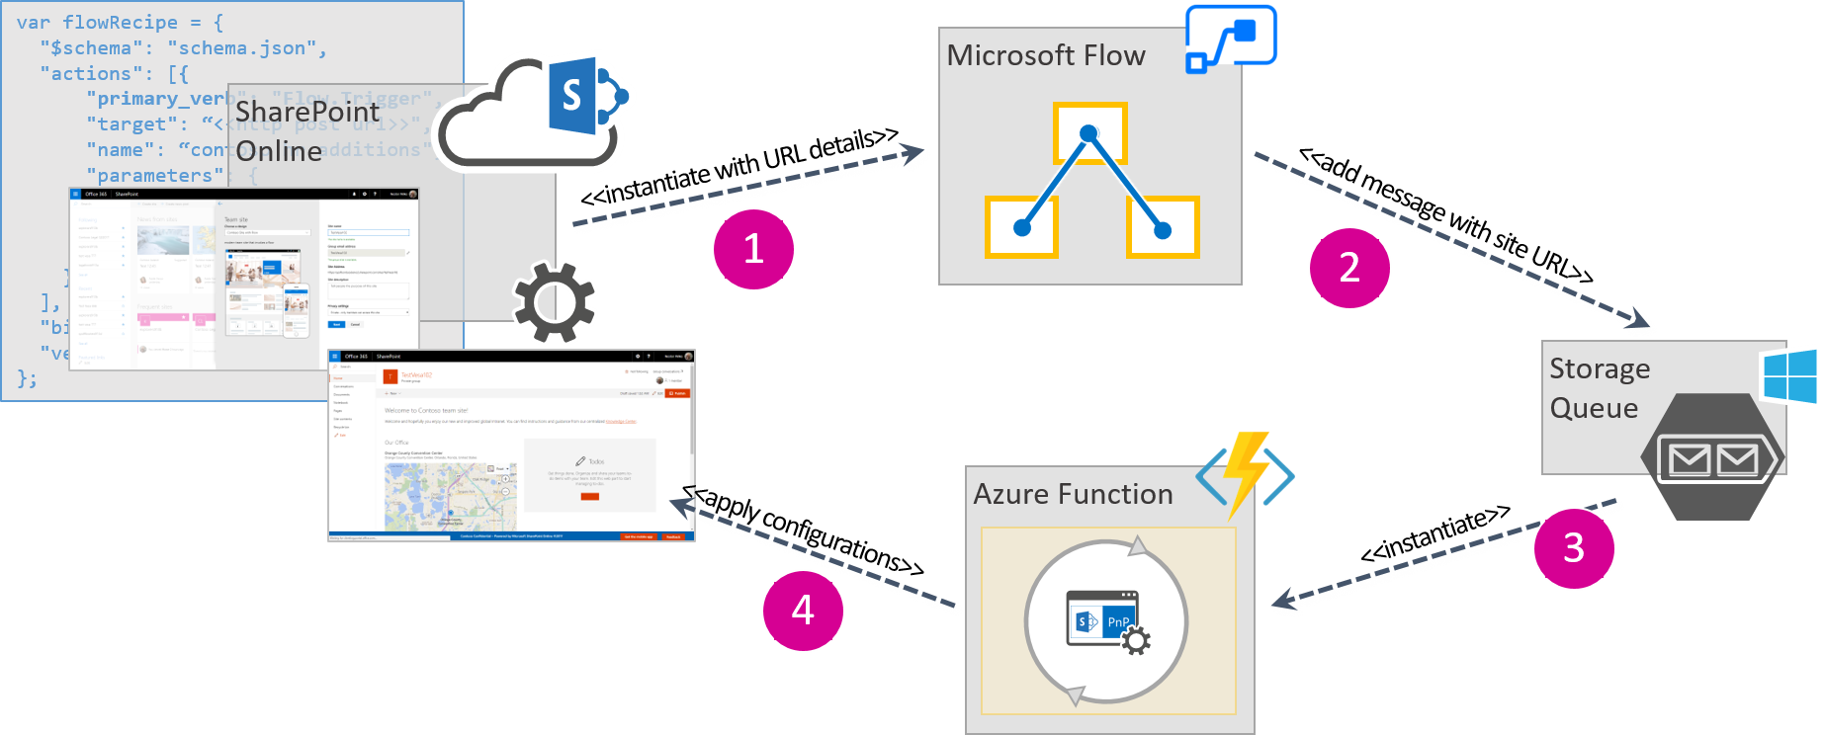
Process Diagram

Slide 14
Tech Bites
Override the default templates
  Add: Set-SPOSiteDesign -Identity 14241386-484e-4744-814c-afc03826d0a8 -IsDefault $true
  Remove: Set-SPOSiteDesign -Identity 14241386-484e-4744-814c-afc03826d0a8 -IsDefault $false
  Scripts can be run through REST Api also
    Eg. RestRequest("/_api/Microsoft.Sharepoint.Utilities.WebTemplateExtensions.SiteScriptUtility.CreateSiteScript(Title=@title)?@title='Contoso theme script'", site_script);
    Note: RestRequest is a custom function and not a inbuilt function

Slide 15
My Few thoughts
Benefits
  Custom Provisioning for custom templates
  Update Status pane for progress and manual refresh
  Easily manageable scripts and design without custom code requirements
  Allow users and AD security groups to use the site design
Limitations
  Not able to start the process in the background
  Need additional hosting for PnP Provisioning Components
  Site Design output status not linked to Provisioning process. The Site template is applied after some time.
  Error and Troubleshooting is distributed and might need time for fixing custom issues
  Office 365 groups cannot be added
  Default designs cannot be modified but can be overridden

Slide 16
Questions / Feedback

